Slide 1
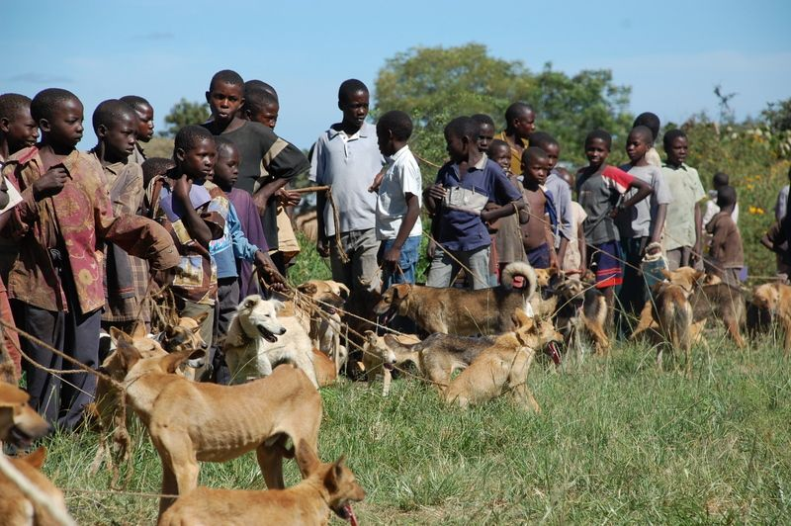
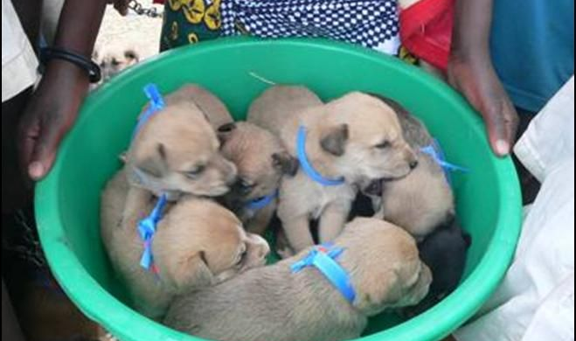
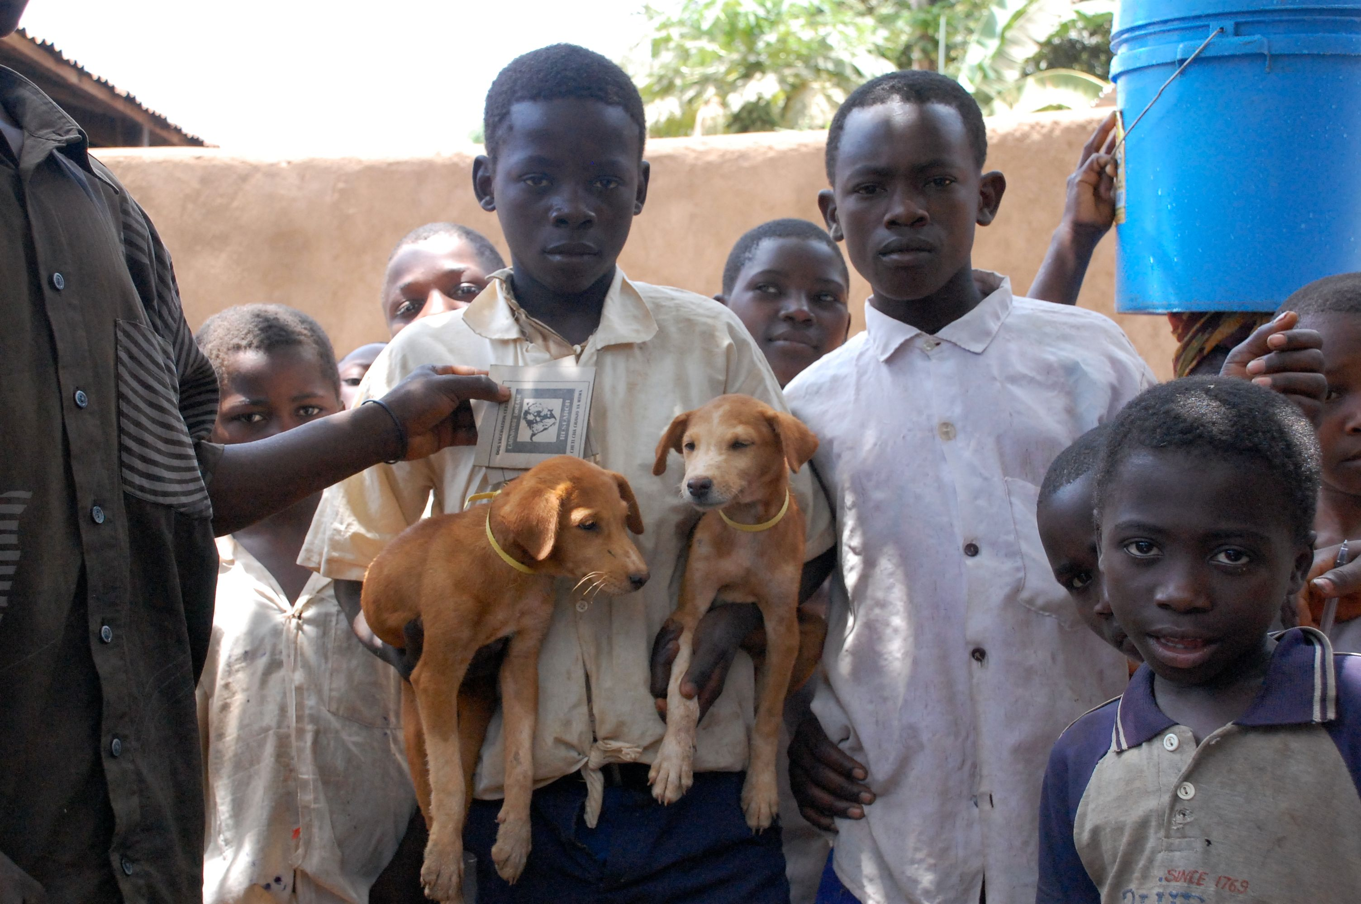


Making Genomic Surveillance Deliver: A Lineage Classification and Nomenclature System to Inform Rabies Elimination
Kathryn Campbell
k.campbell.1@research.gla.ac.uk
@ThatKatC

Slide 2
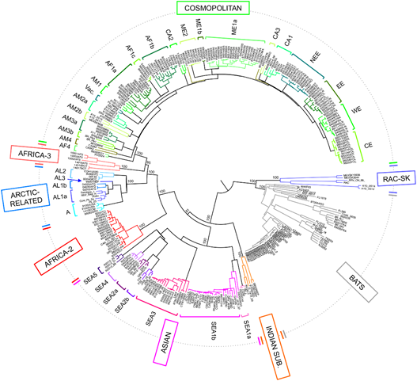
The global rabies phylogeny reveals large-scale geographic structure
2 major phylogenetic groups; bat related and dog related (5-7 clades)
Same geographical area group closely together
Host species also important but less so
Major clades are segregated by barriers
Oceans, mountain ranges, human factors
Troupin et. al (2016)
Notes:
Troupin 6 (figure)
Fischer 4
Africa 3 only mongoose
Box bats vs dogs

Slide 3
Greater phylogenetic resolution is needed to guide control programmes
Progress towards elimination, should see reduction in viral diversity
Need to see if any lineages have become extinct, or if any are persisting
Use this to direct elimination efforts
Monitor how we are progressing towards elimination
Needs a high-definition classification system
Current system is very broad – often only 1 subclade circulating
Can’t track changes
Needs to be universal
Lots of studies, but all define and name lineages differently
Can’t compare and communicate these
BUT
Need one, high definition system to classify all rabies globally

Slide 4
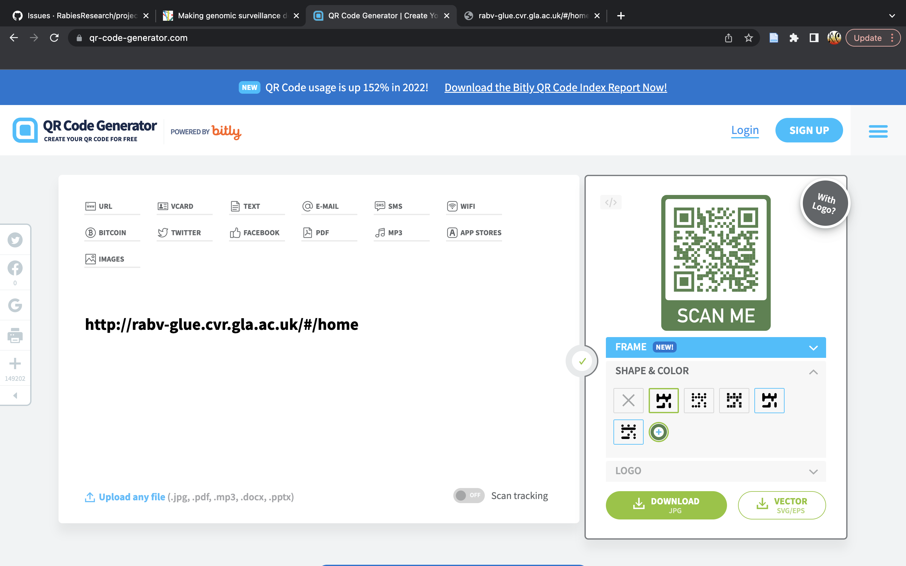

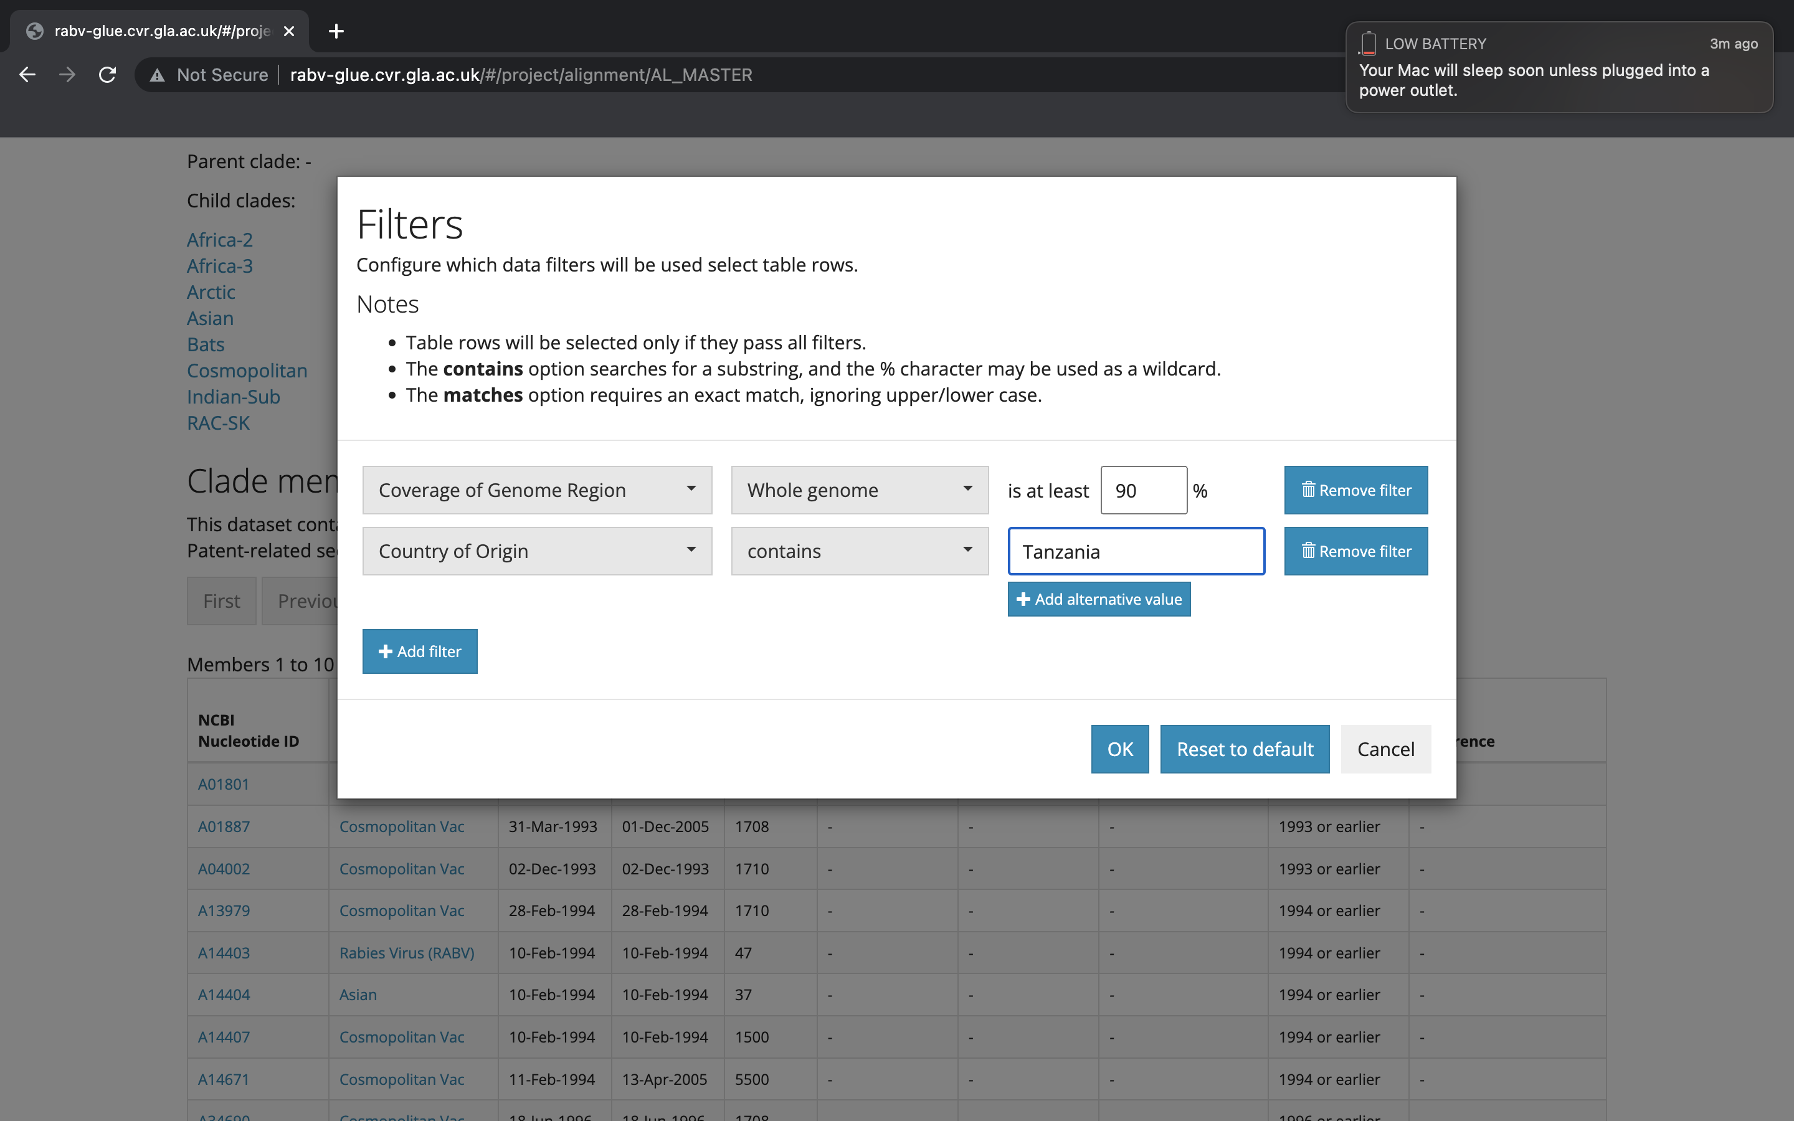
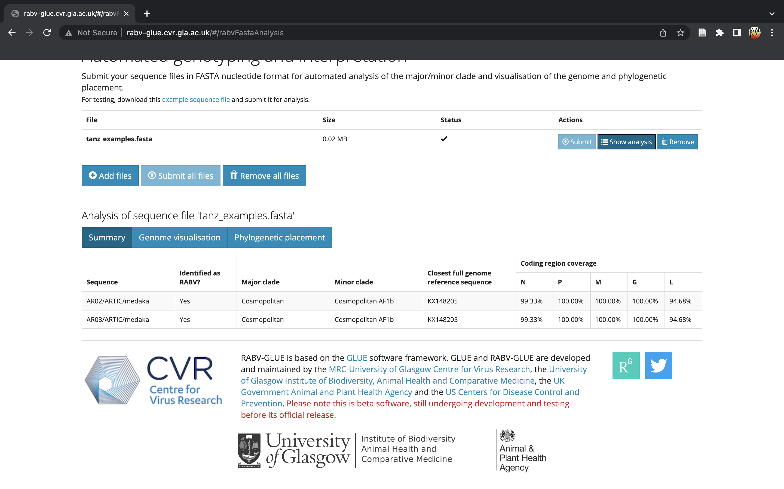
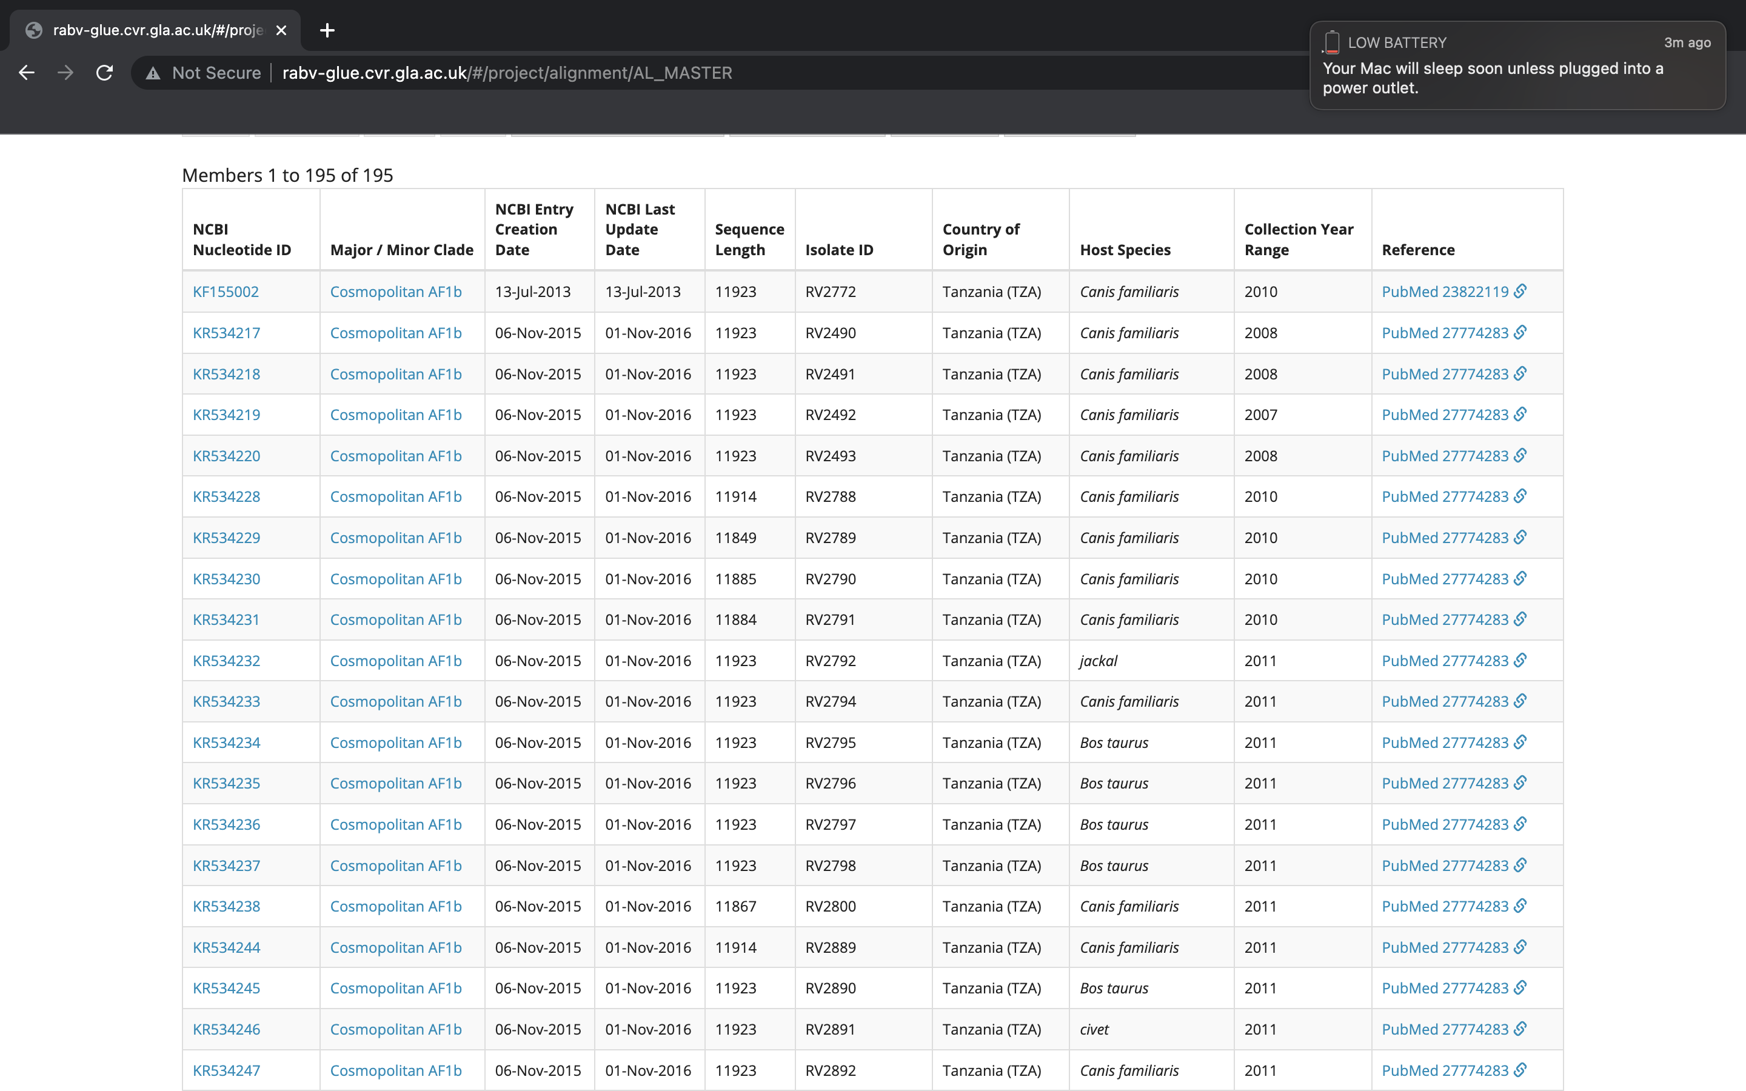
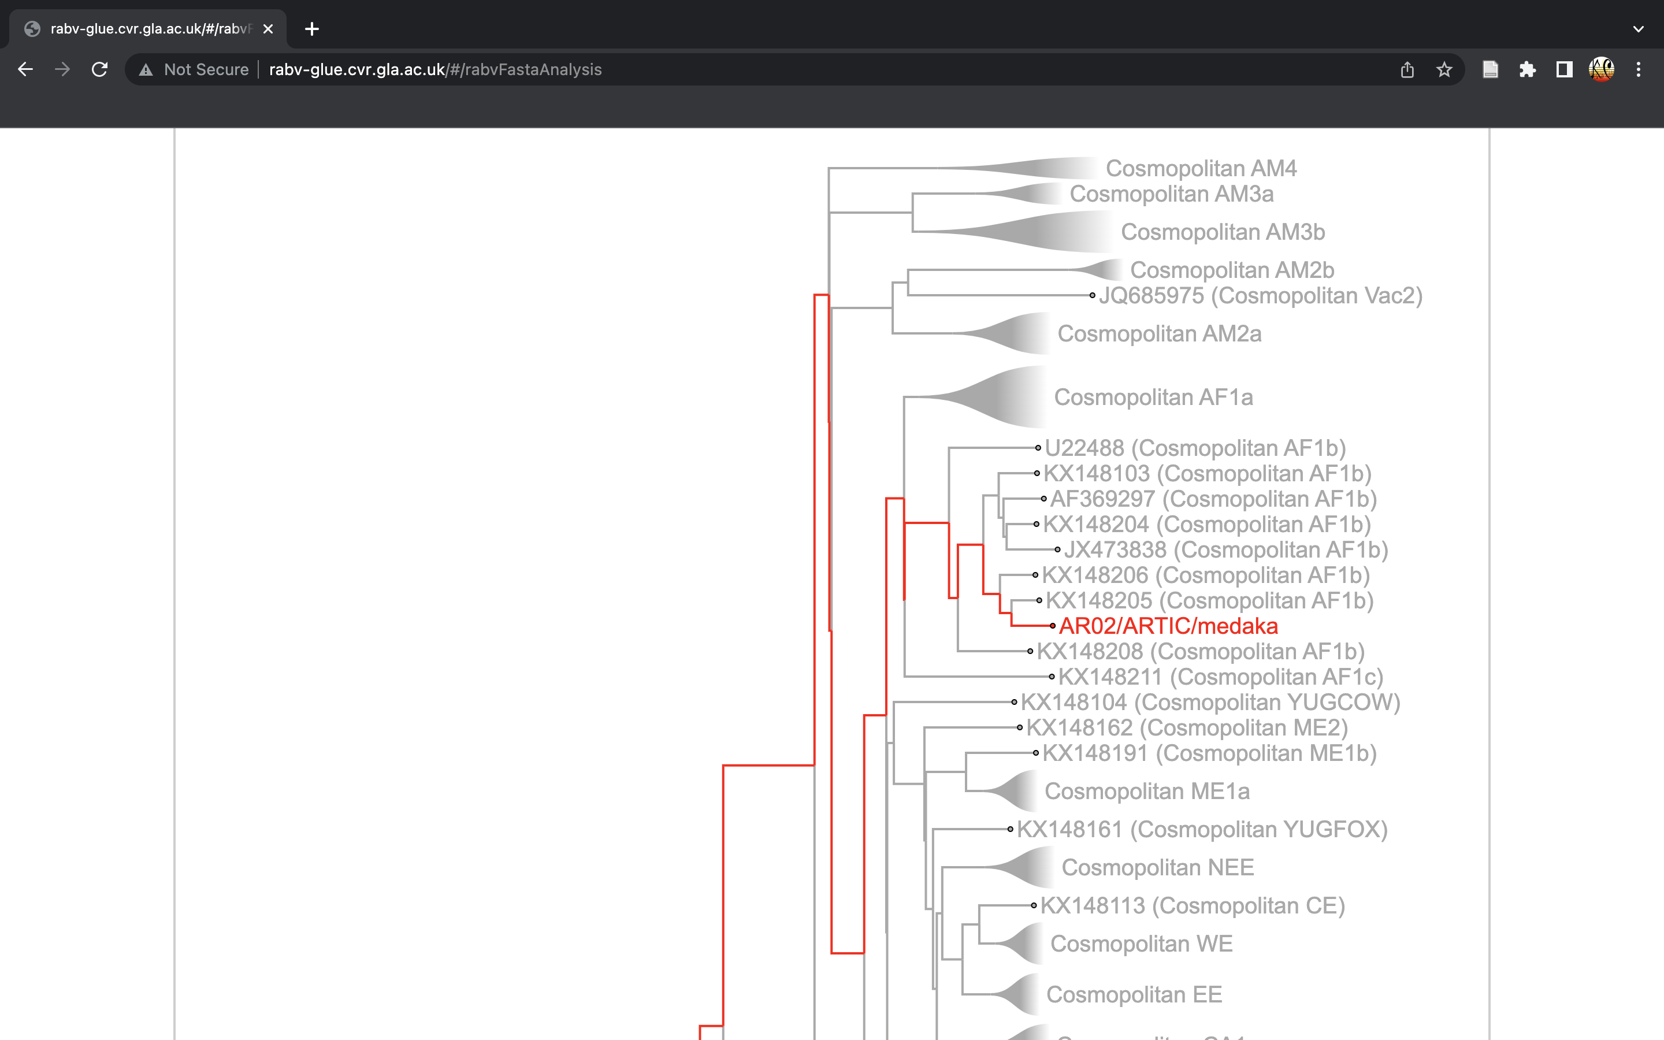
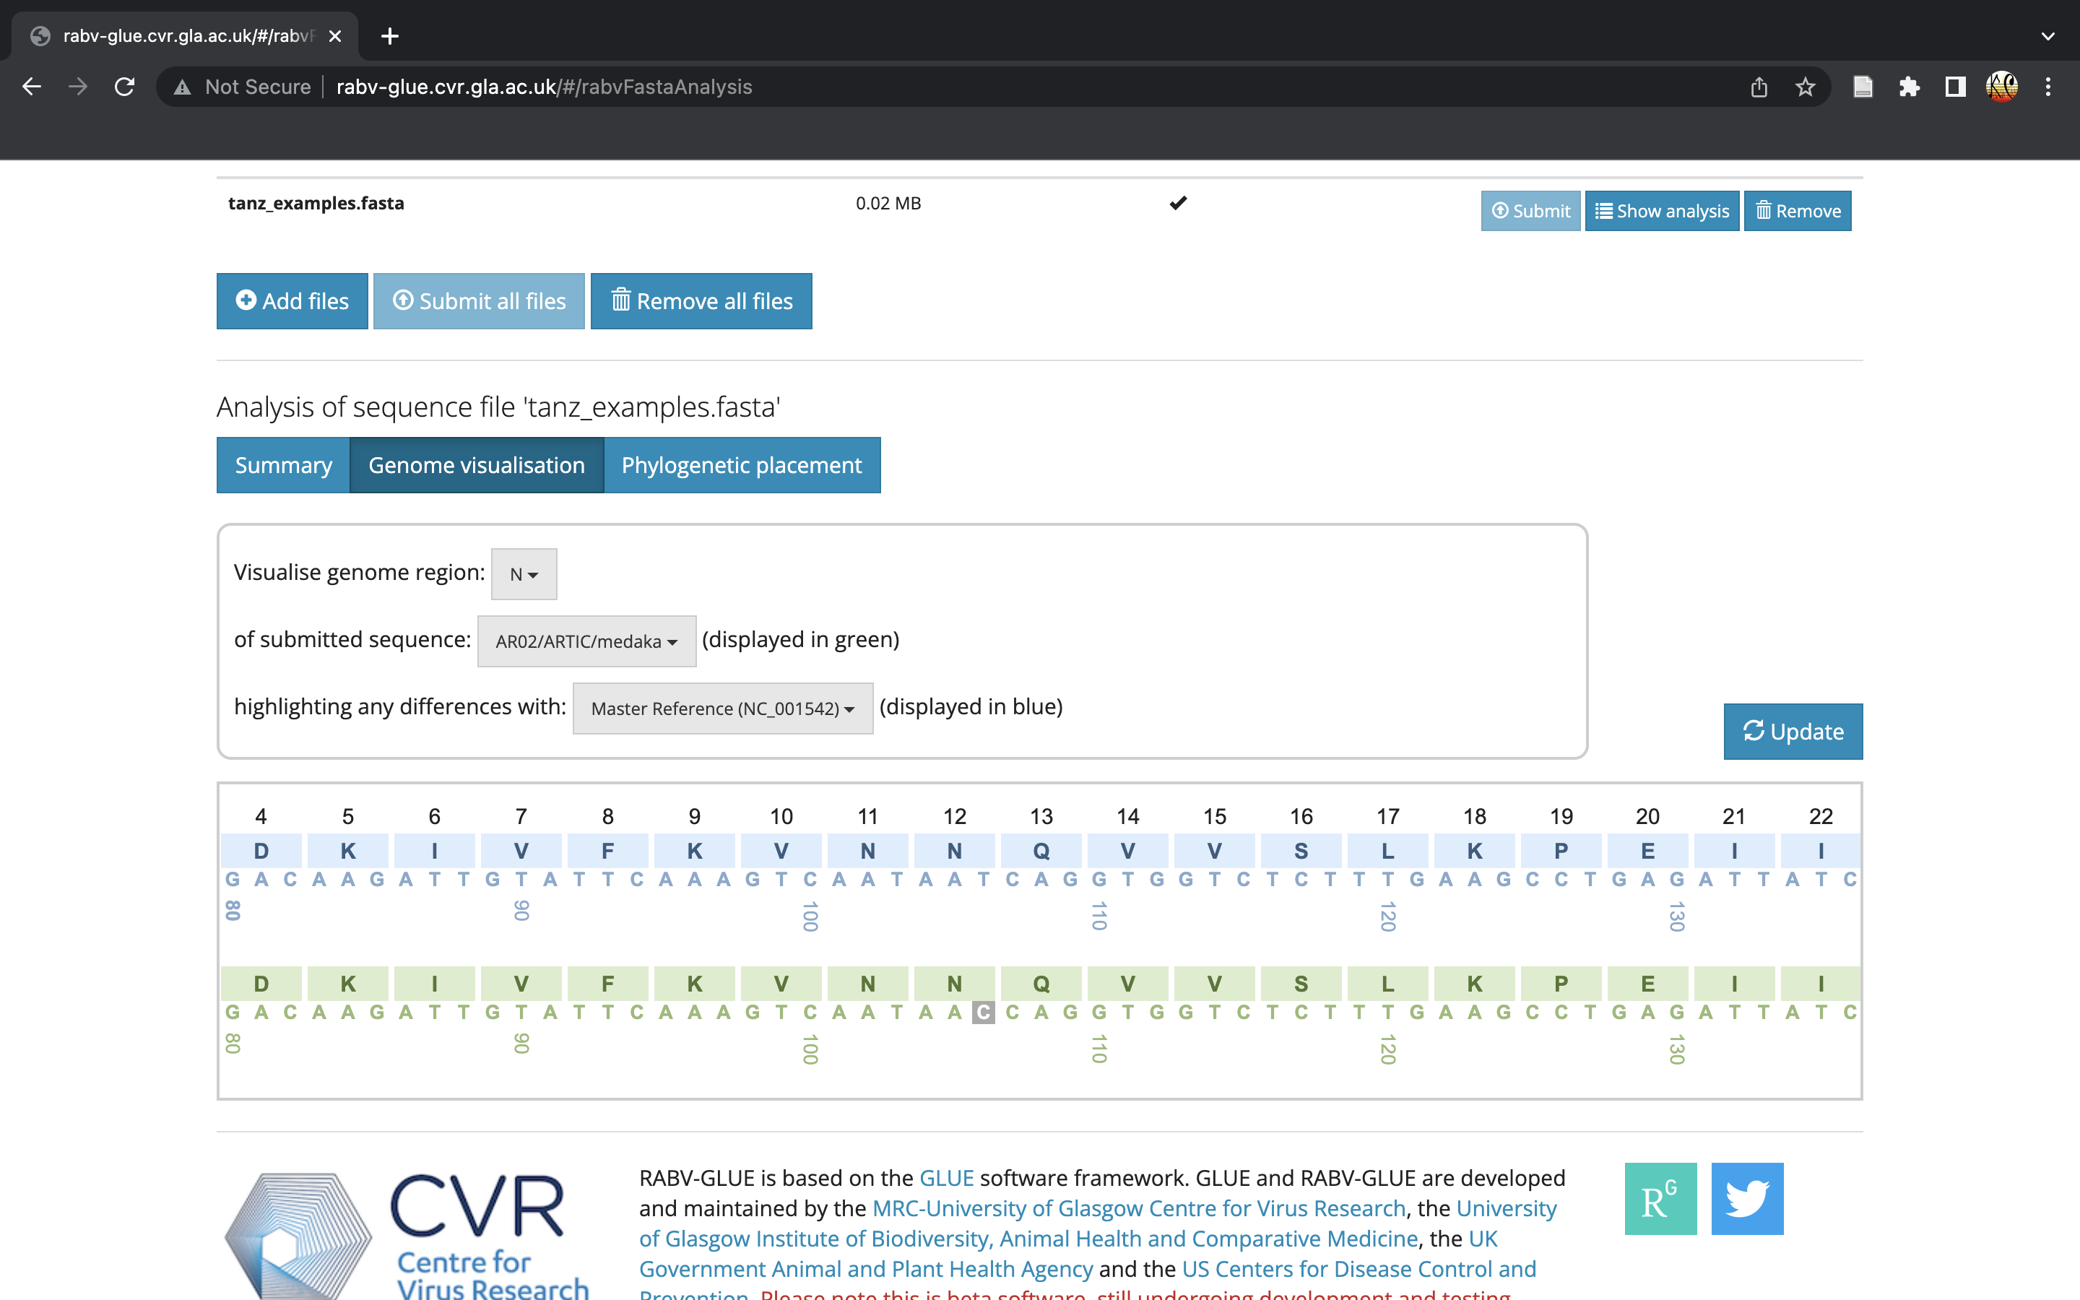
RABV-GLUE
Find Relevant Sequences and Studies | Analyse Your Own Sequences
Filter for only sequences of interest | Relevant information about the sequences
See and download all the relevant sequences and information about them
See the closest relatives
Are there any mutations?

Slide 5
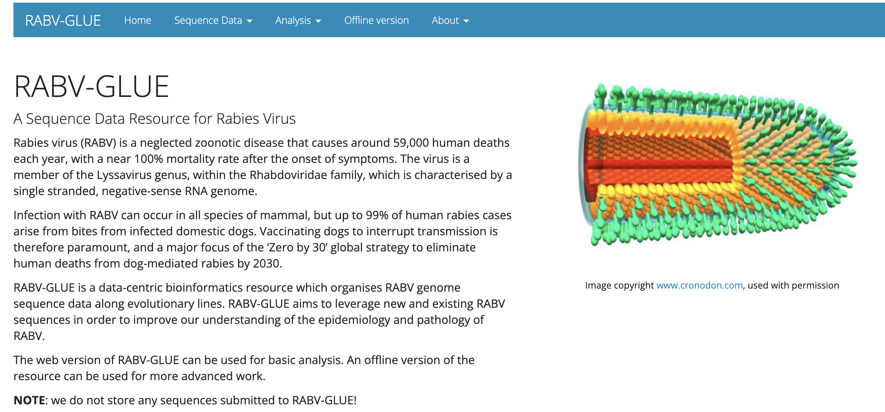

Data Curation
Over 26,000 publicly available RABV sequences
c10,000 entries missing essential metadata
Collection year, host, location
Manual searching in publications
http://rabv-glue.cvr.gla.ac.uk/#/home

Slide 6
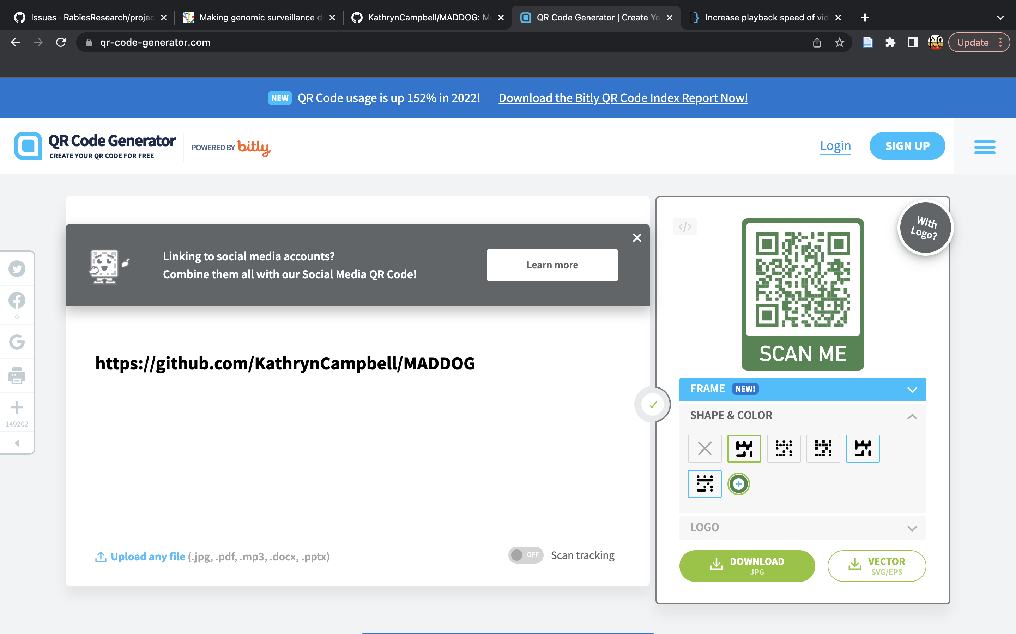
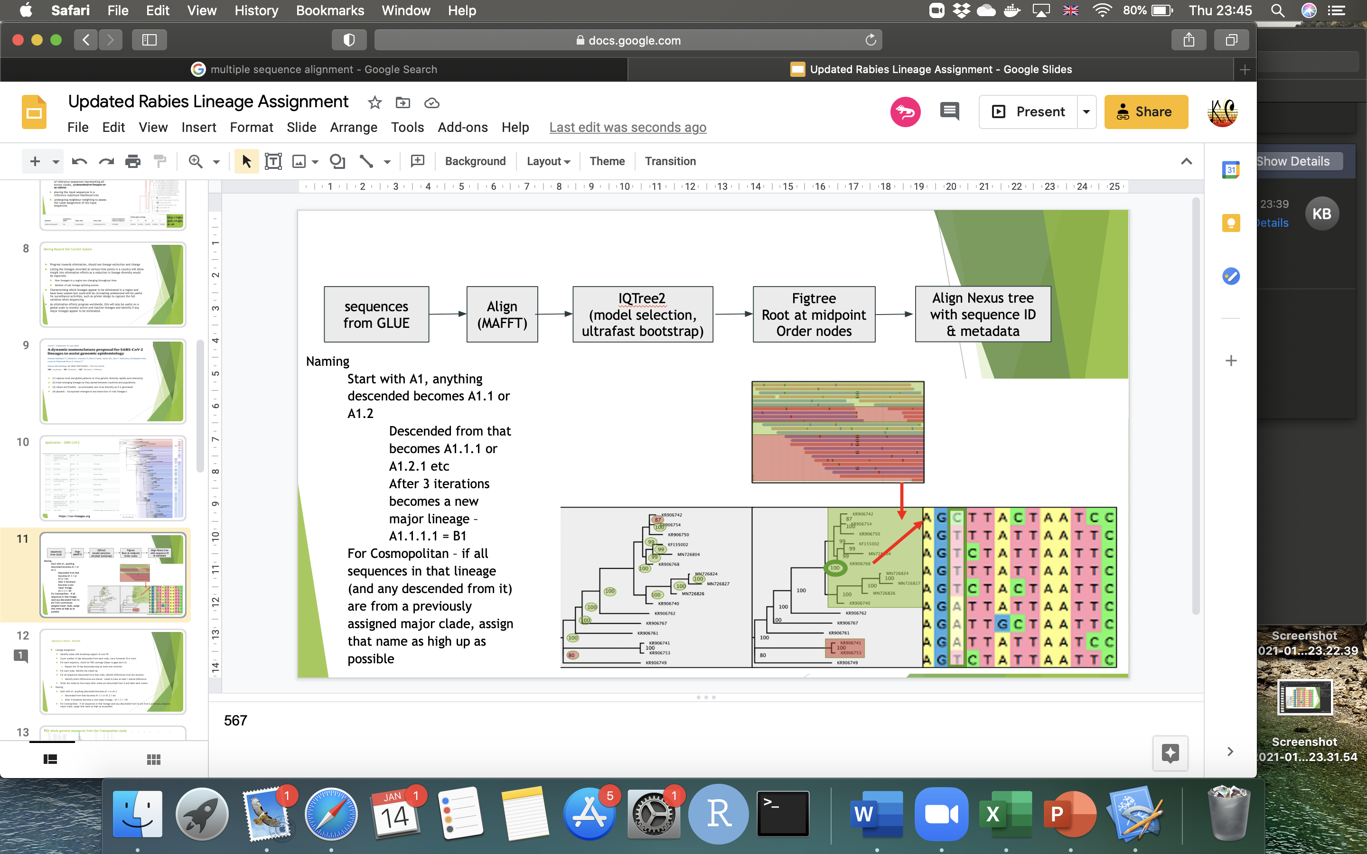
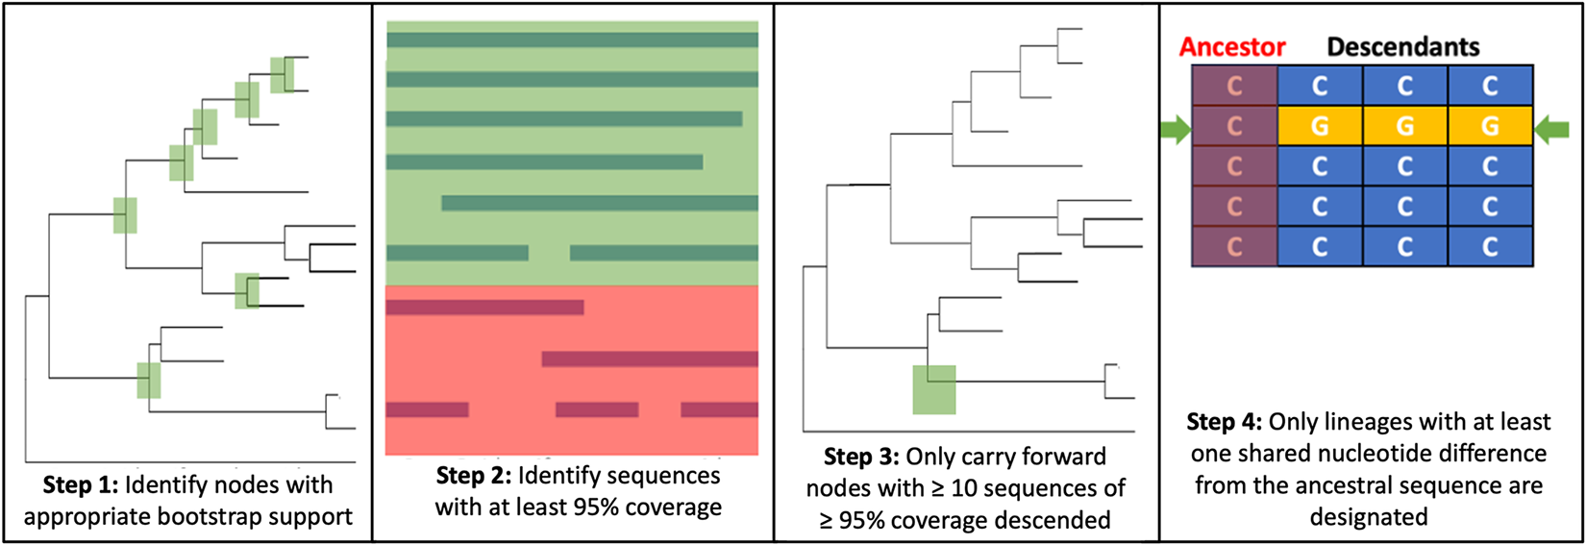
MAD DOG
Increase the resolution
See the patterns
Stop the Spread
Method for Assignment, Definition and Designation Of Global Lineages
METHODS
Modelled after SARS-CoV-2 lineage designation
Different parameters to consider for rabies!
Time scale
Existing classifications
Tracked since emergence vs decades of endemic circulation
Data Processing
Lineage Designation
Campbell et al. 2022, PLoS Pathogens

Slide 7
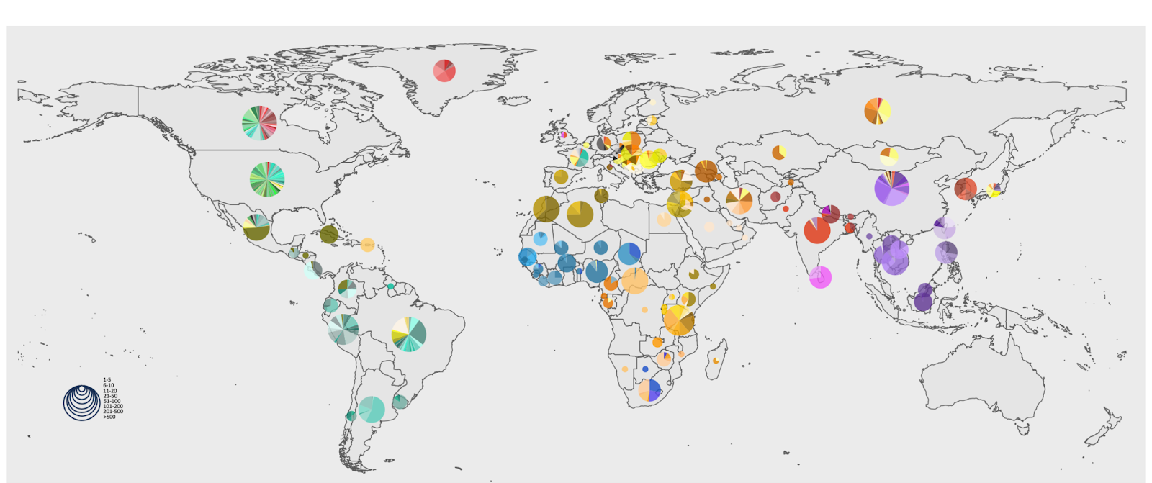

Slide 8
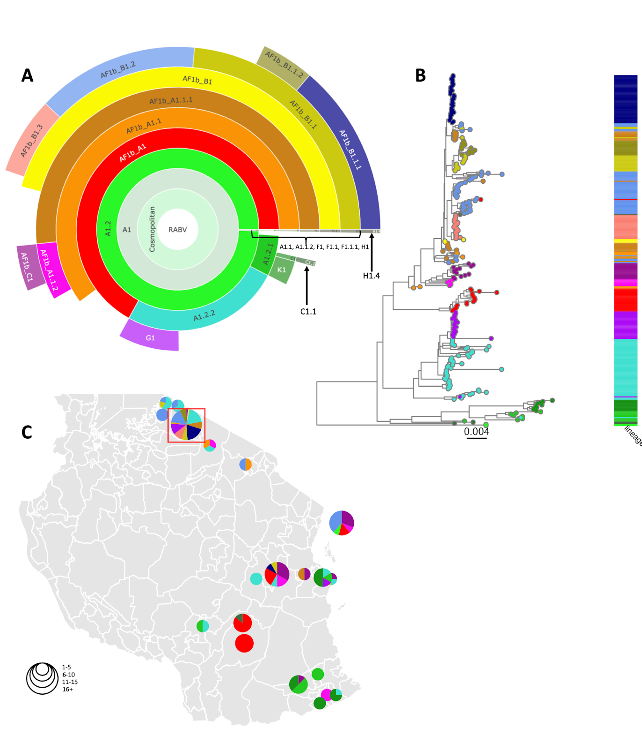
Lineage Overview
216 WGS from Serengeti (+90 from Tanzania)
14 lineages (+4 from Tanzania)
4 Serengeti only, 7 also seen in other countries across Africa

Slide 9
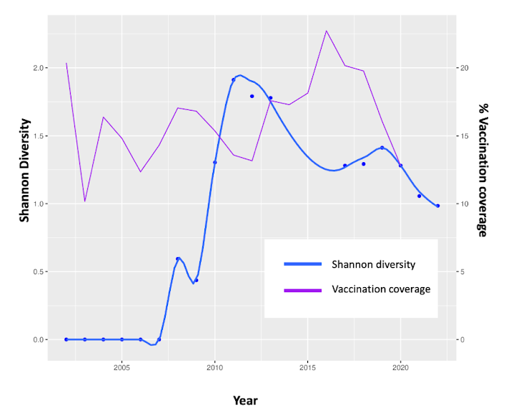
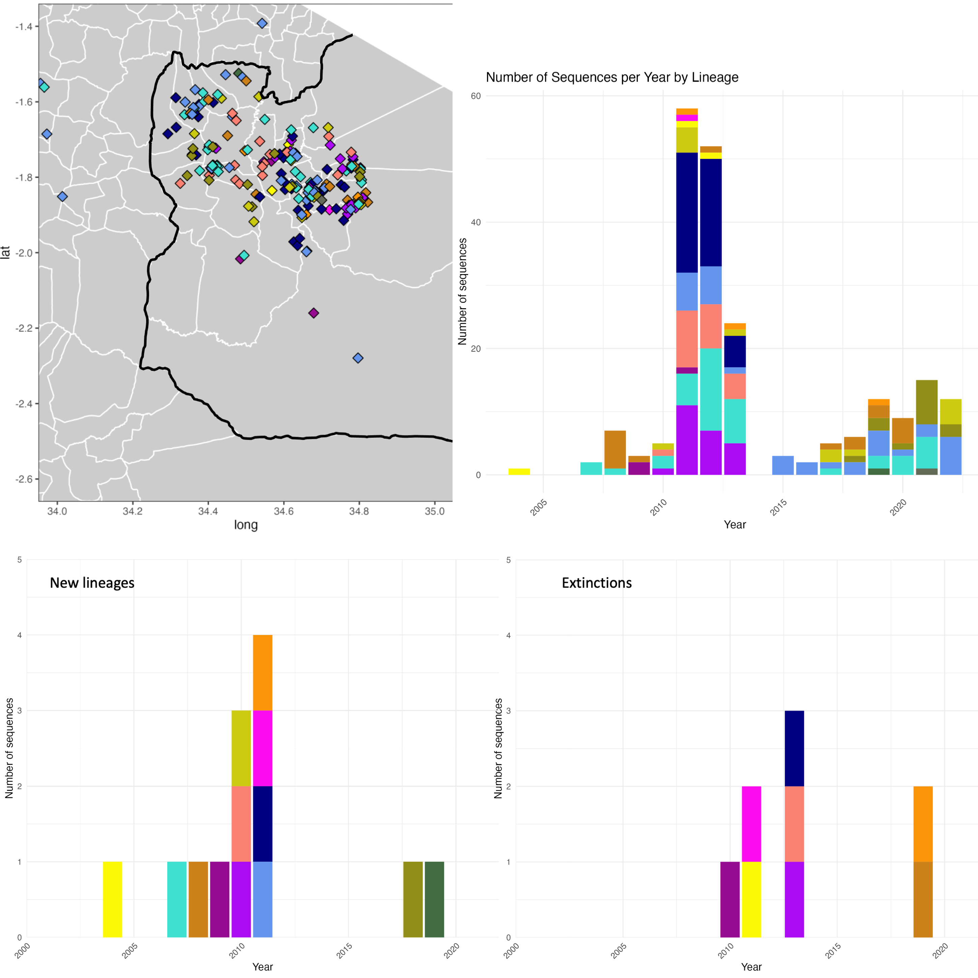
Changes over time
Steadily reducing viral diversity
Some lineages persist
Some emerge and then go extinct
9 not seen in 2 years, 6 not seen in 5 years

Slide 10
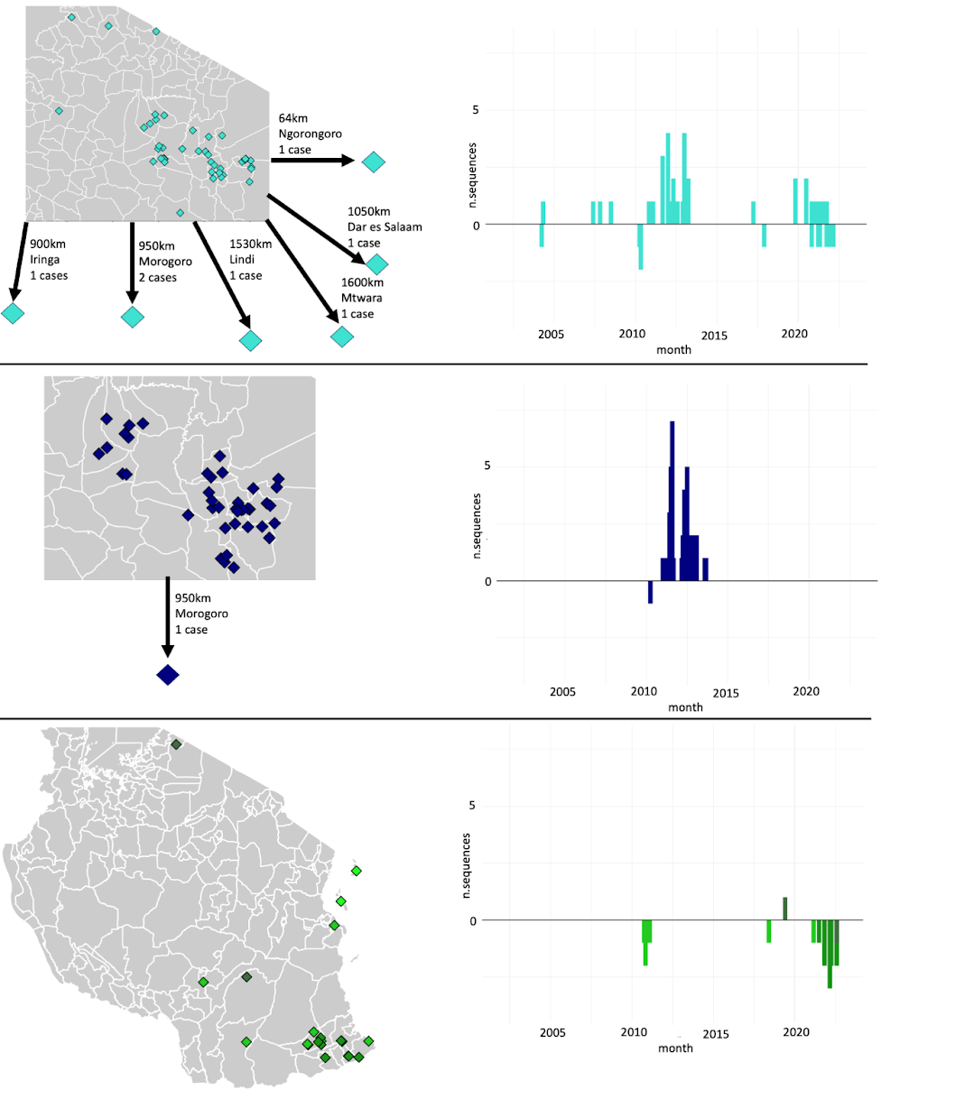
Metapopulation dynamics
Cases can be introduced or reintroduced from wider Tanzania
Some establish, others are single incursions
Vaccination coverage needs to be maintained!

Slide 11
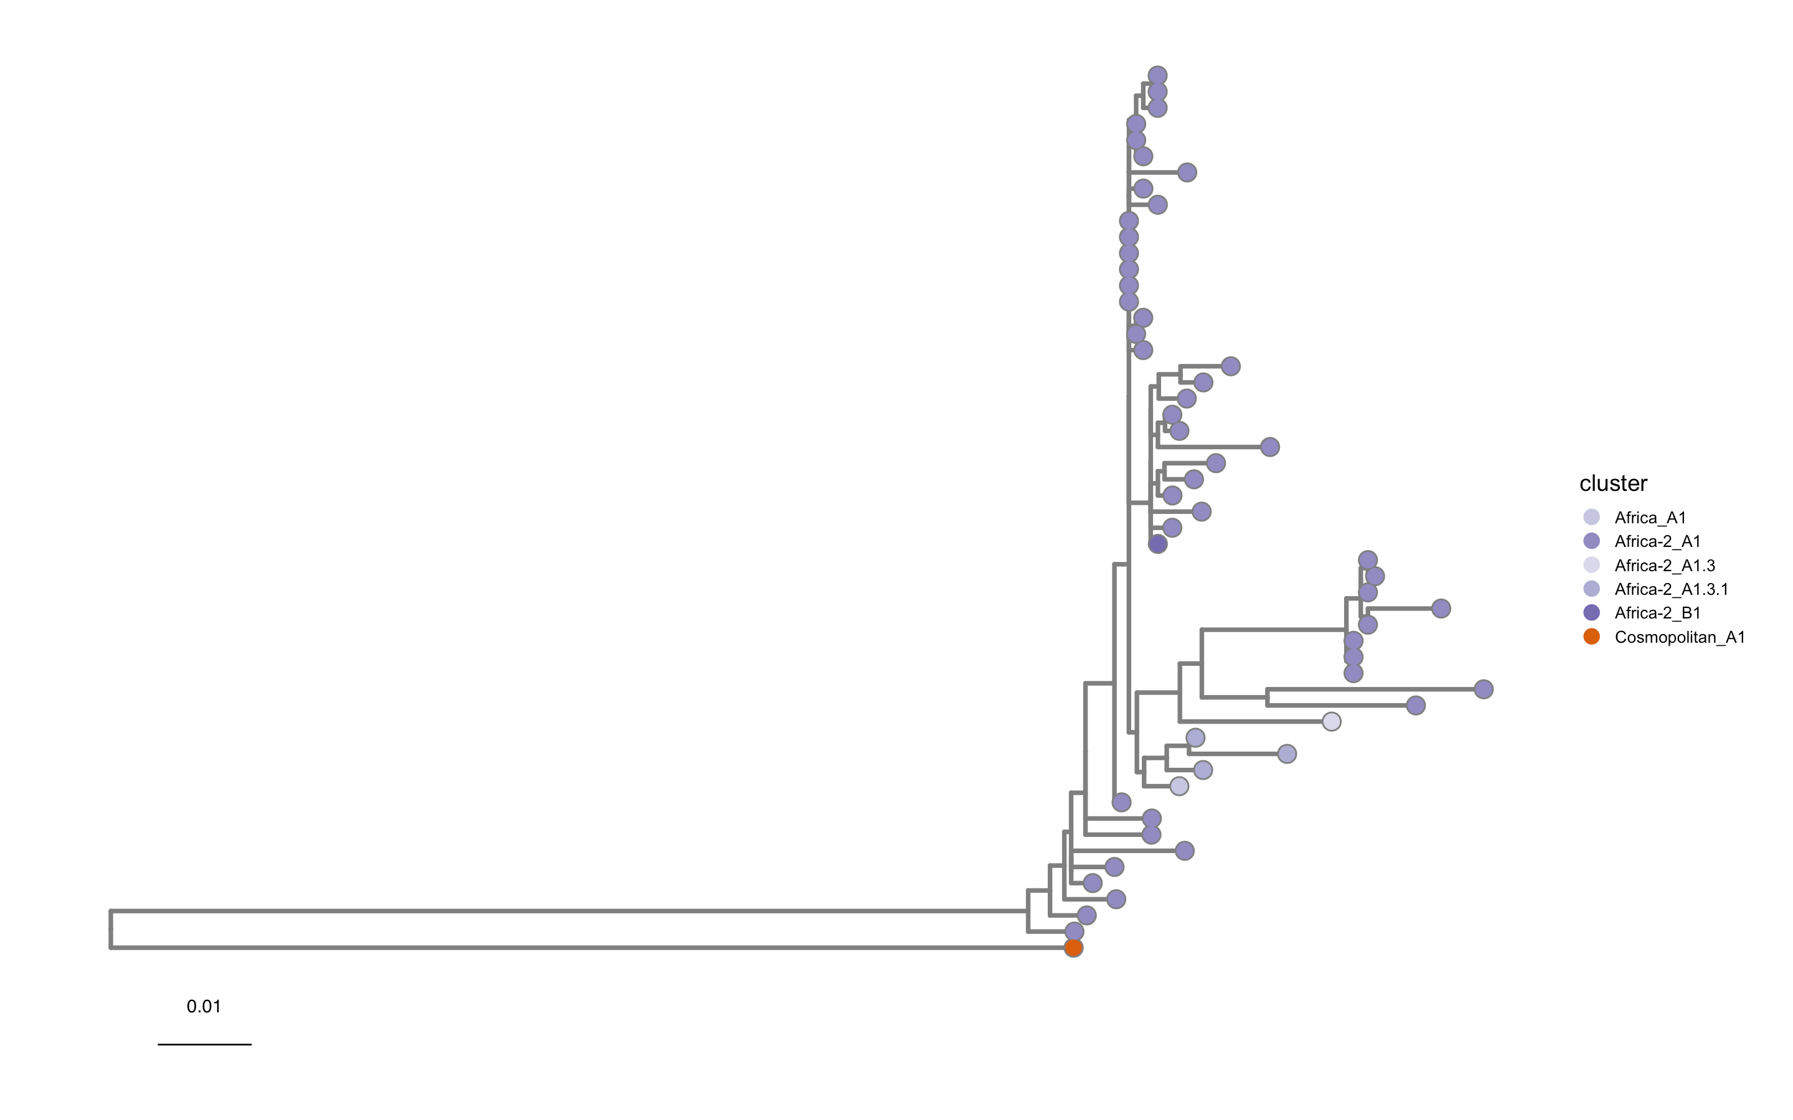
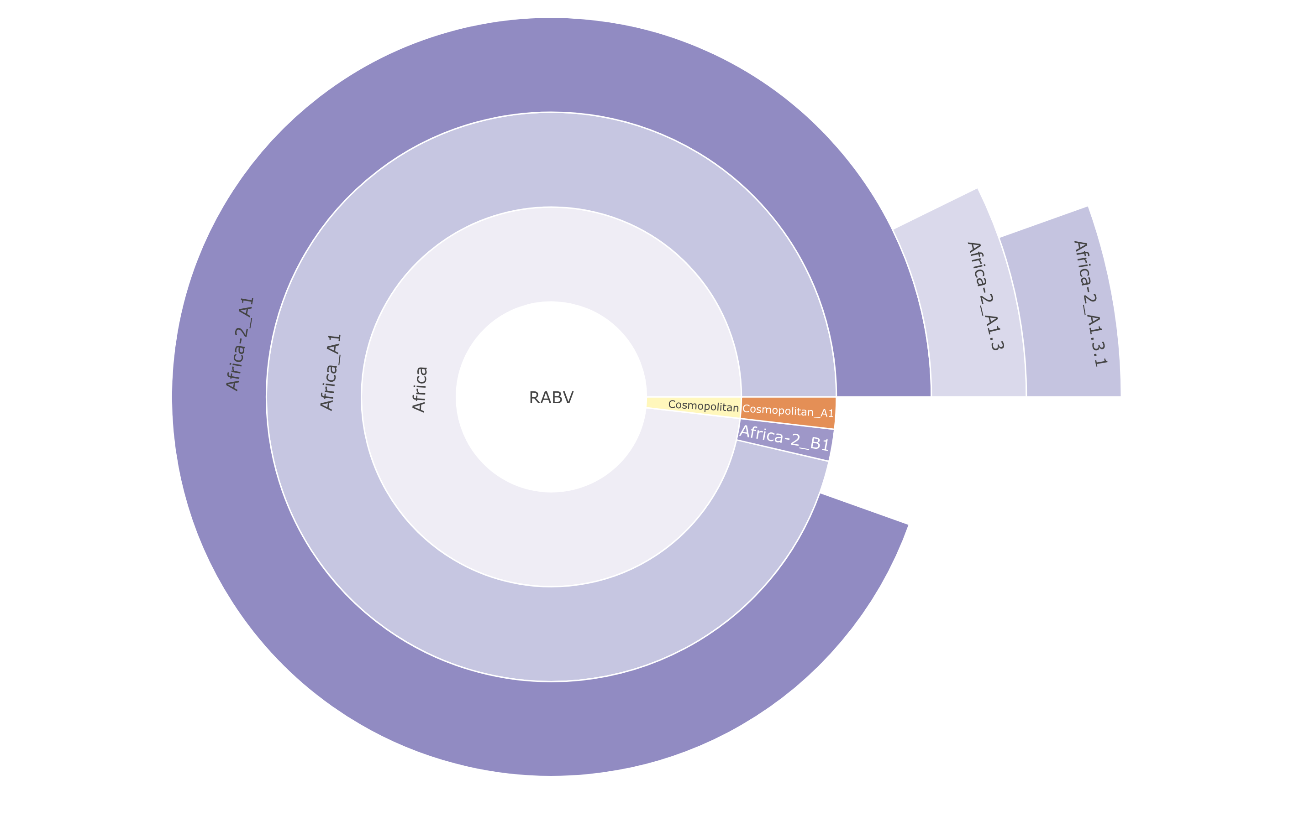

Slide 12
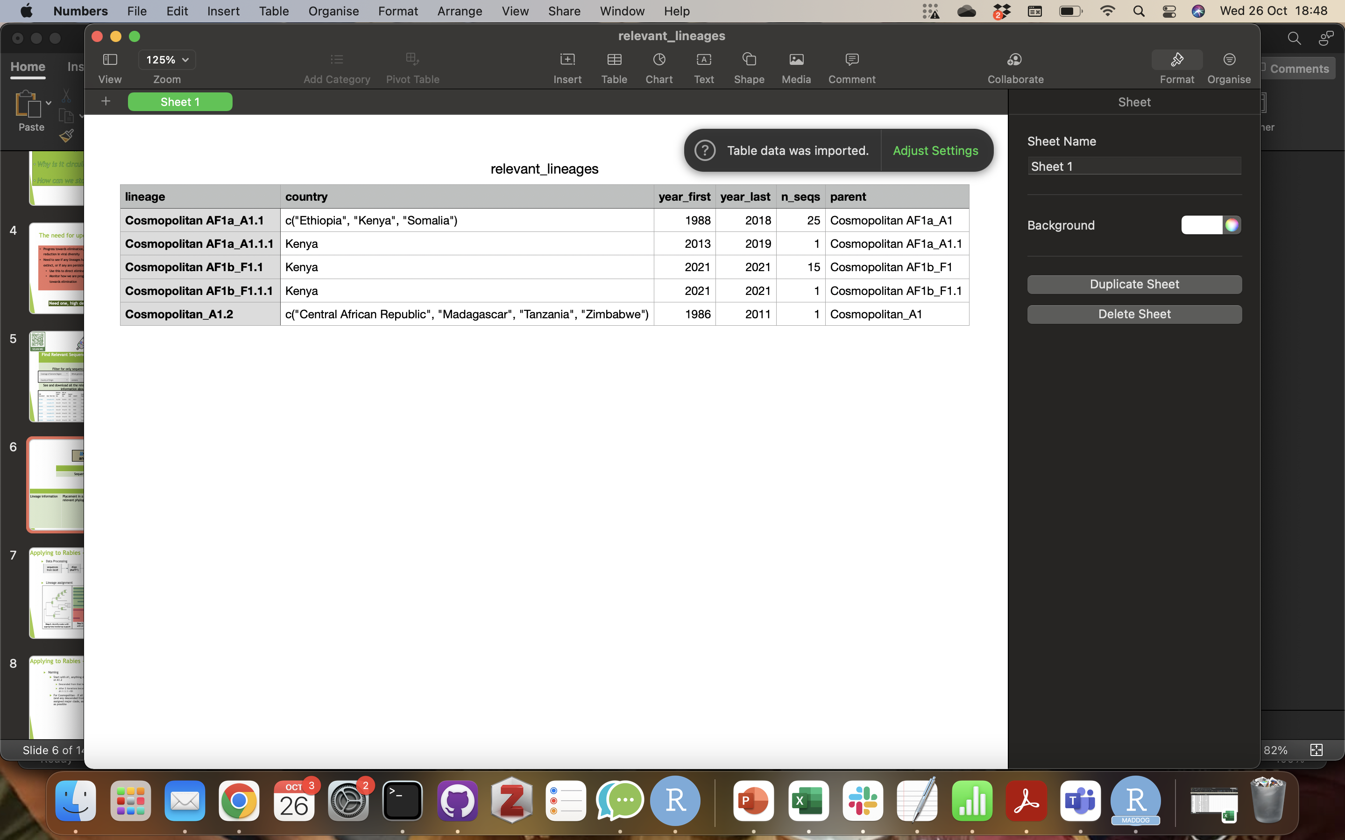
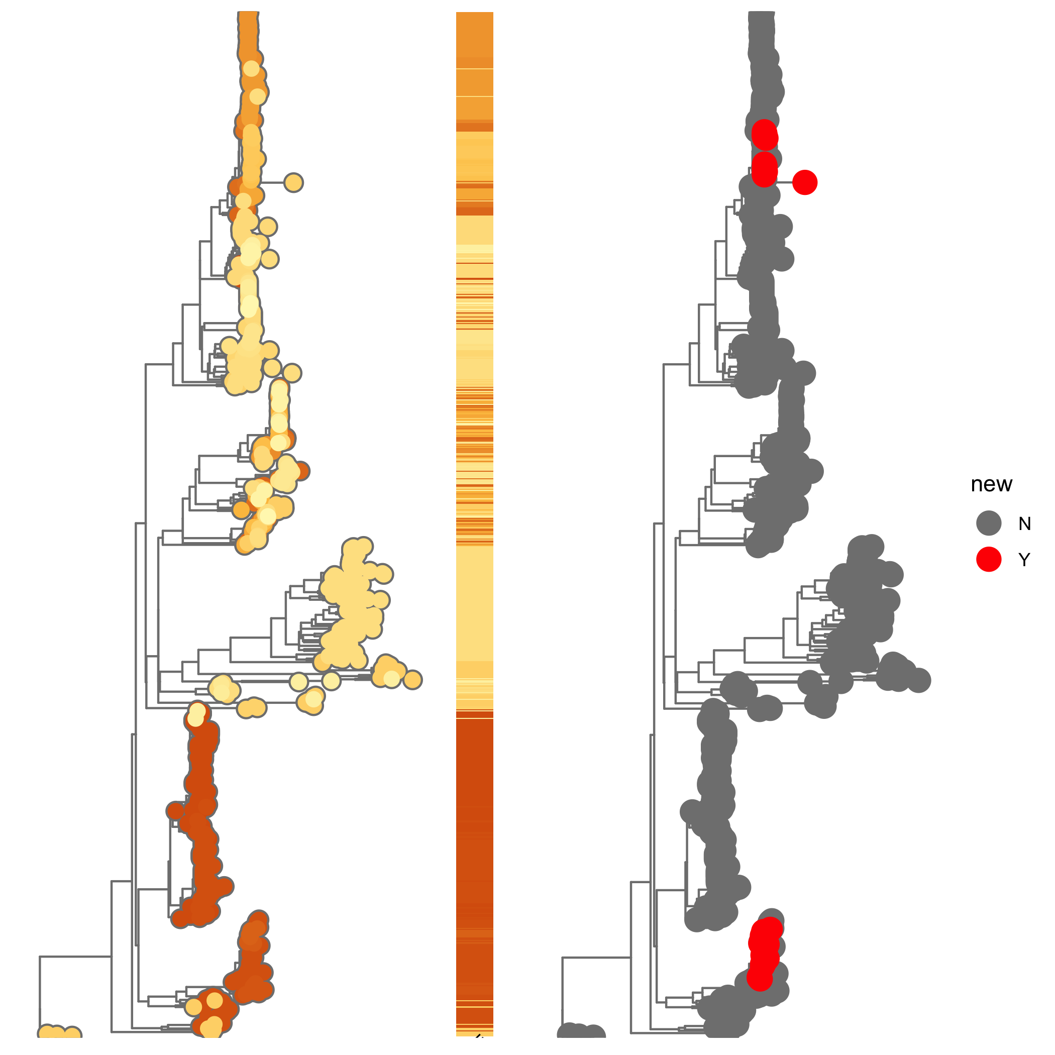
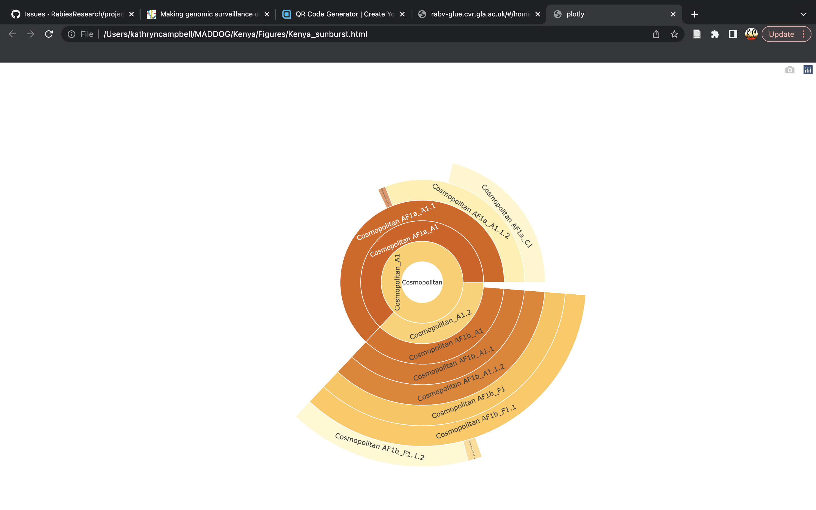
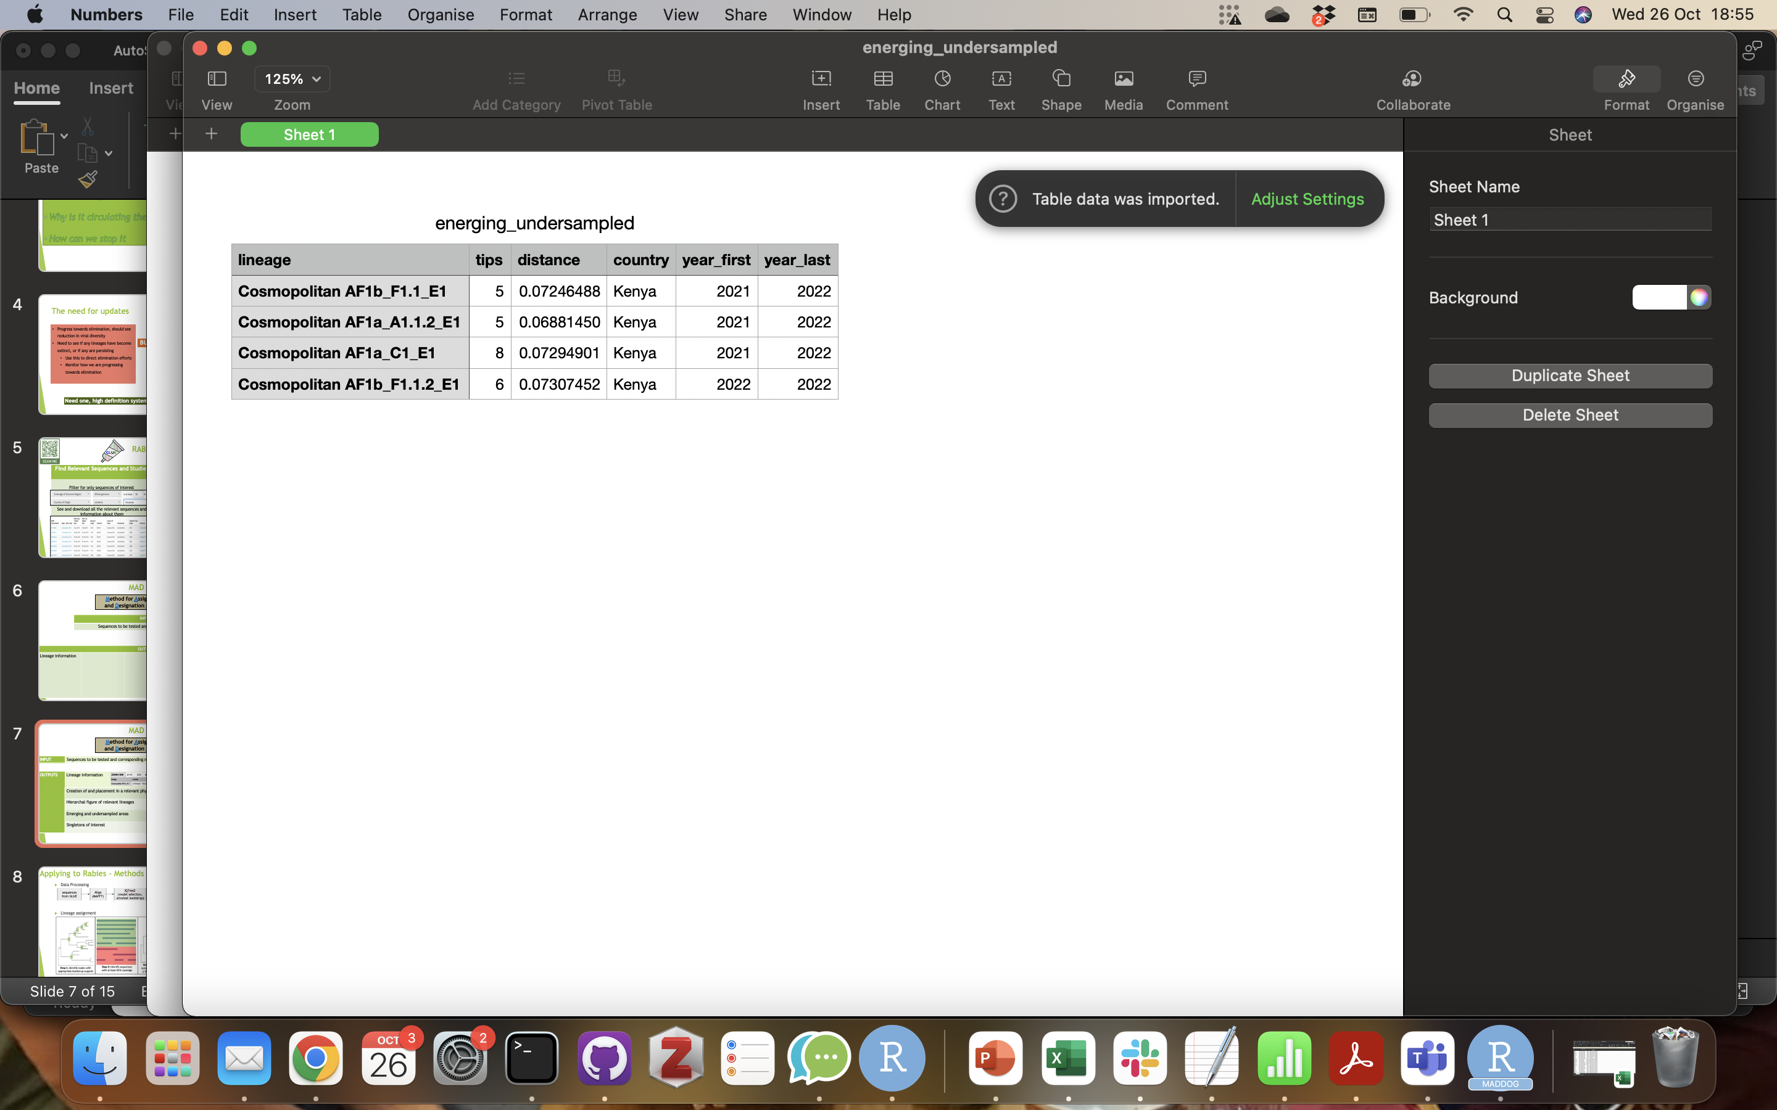
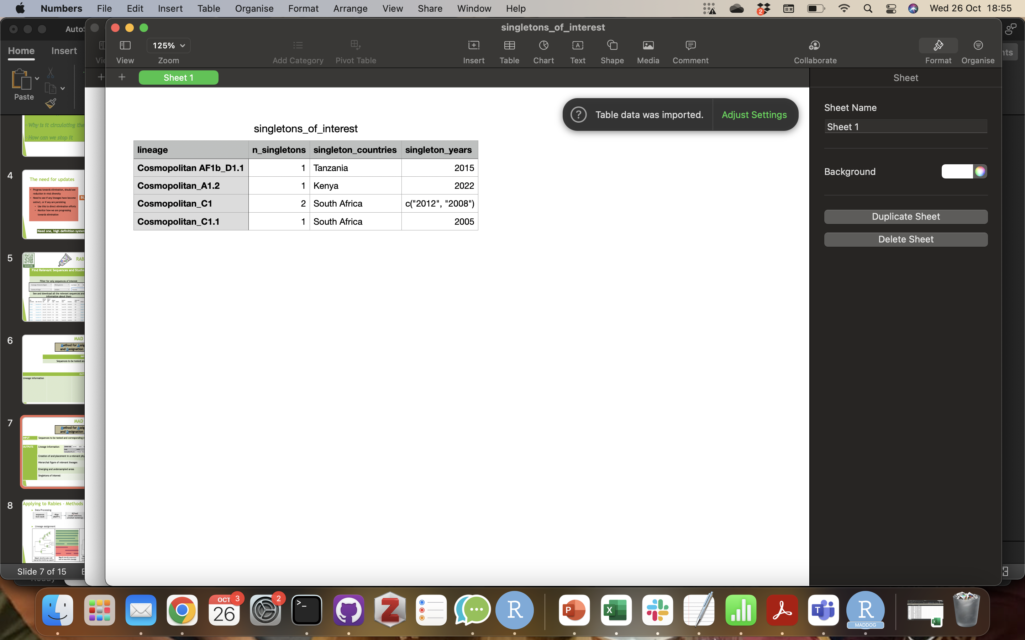
MAD DOG
Method for Assignment, Definition and Designation Of Global Lineages
INPUT | Sequences to be tested and corresponding metadata
OUTPUTS | Lineage information
 | Creation of and placement in a relevant phylogeny
 | Hierarchal figure of relevant lineages
 | Emerging and undersampled areas
 | Singletons of Interest

Slide 13
Assignment or Designation?
Assignment is an initial, quick, less computationally intensive step for finding out roughly which lineages sequences are from
Sequences are compared against a reference set for each lineage, and are assigned the lineage of the closest match in the reference
Designation is a slow, thorough, computationally intensive process for finding new lineages and accurately assigning existing lineages
This involves comparison with all public whole genome and N gene sequences, and a tree built from your sequences and relevant public ones.
The position sequences fall in the tree compared to existing sequences tells us the lineage. We then check to see if all of the rules are met on any new groups of sequences to determine new lineages

Slide 14
Usage
MADDOG is really easy to use!
2 steps to set up:
Download the MADDOG repository from GitHub
Set up the MADDOG conda environment
2 data requirements:
A fasta file with all the sequences to be tested
A csv metadata file with sequence IDs exactly matching the fasta file, and the year and country of collection for each sequence
4 steps to run:
Pull the GitHub repository to make sure any changes are integrated
Enter the MADDOG conda environment
Navigate to the MADDOG folder in command line
Run the command sh designation.sh or sh assignment.sh

Slide 15
Usage
MADDOG is really easy to use!
2 steps to set up:
Download the MADDOG repository from GitHub
Set up the MADDOG conda environment
2 data requirements:
A fasta file with all the sequences to be tested
A csv metadata file with sequence IDs exactly matching the fasta file, and the year and country of collection for each sequence
4 steps to run:
Pull the GitHub repository to make sure any changes are integrated
Enter the MADDOG conda environment
Navigate to the MADDOG folder in command line
Run the command sh designation.sh or sh assignment.sh

Slide 16
Practical 1
Follow the instructions on GitHub in day5/day5_GLUE_MADDOG.md

Slide 17
Practical 2
Follow the instructions in day5_MADDOG_results.md

Slide 18



Acknowledgements
Katie Hampson
Kirstyn Brunker
Rob Gifford
Roman Biek
Rowan Durrant
Andrew Rambaut
Aine O’Toole
Verity Hill
Gurdeep Jaswant
Criselda Bautista

Slide 19
